Slide 1
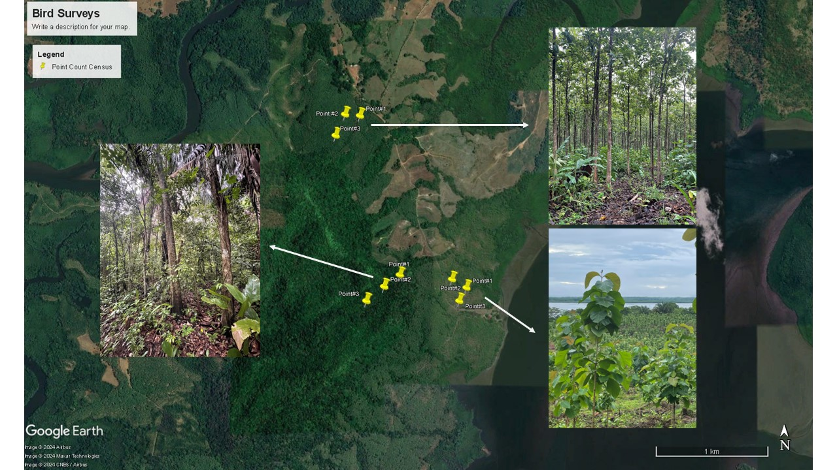
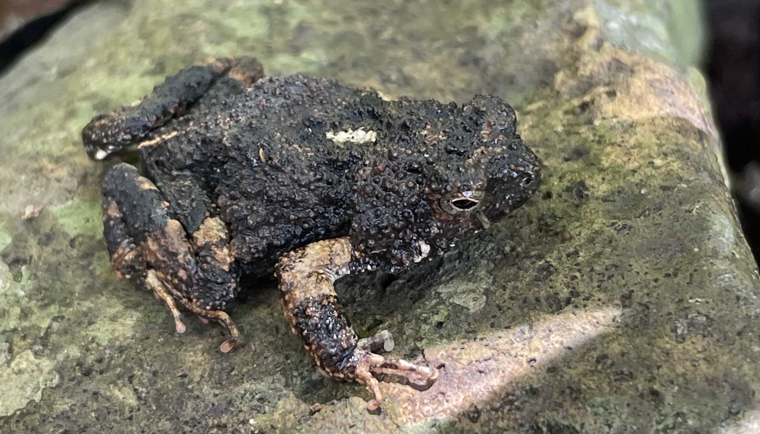
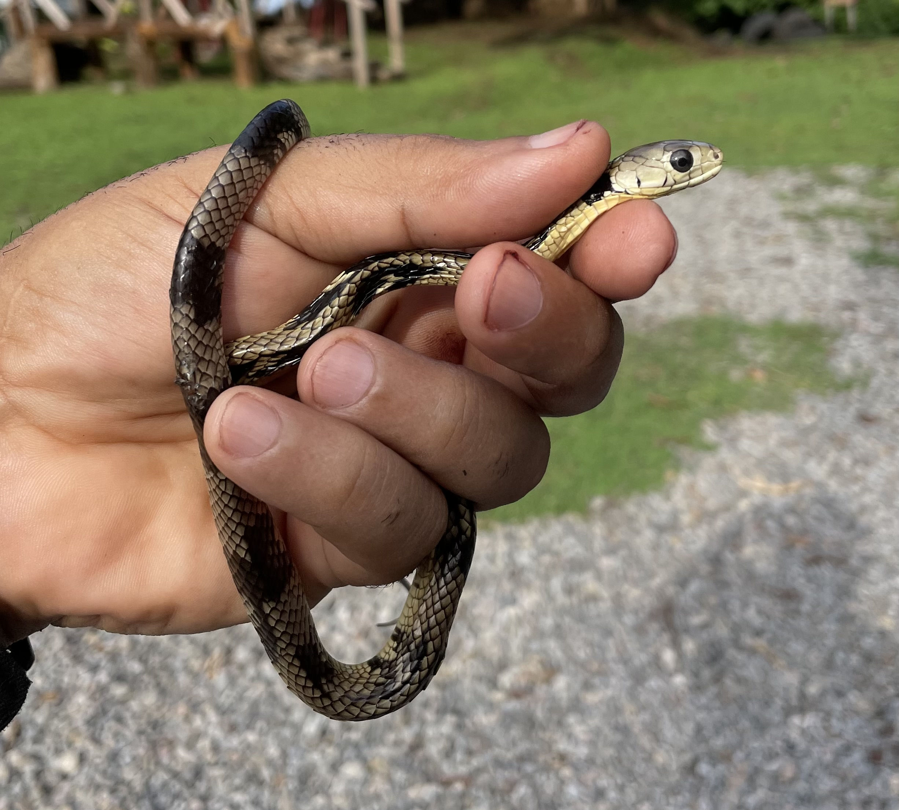
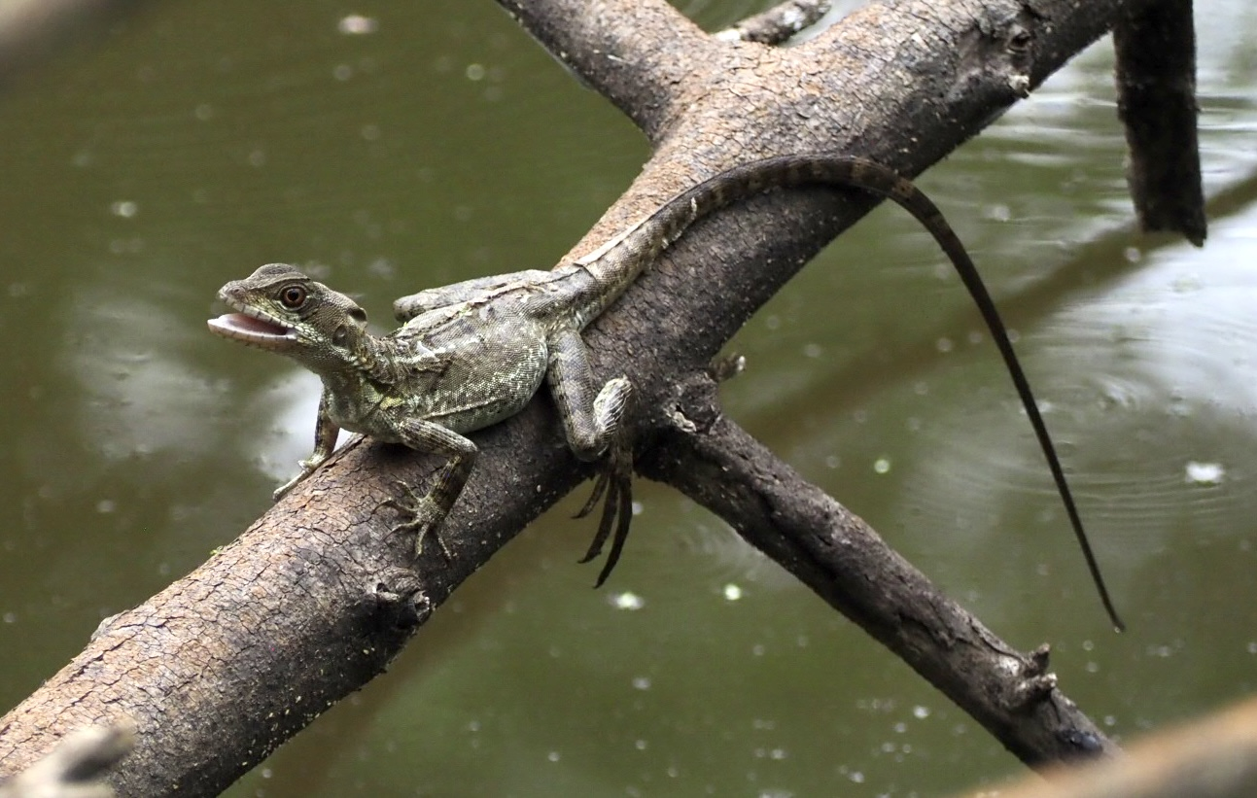
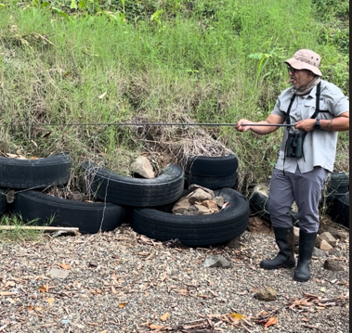
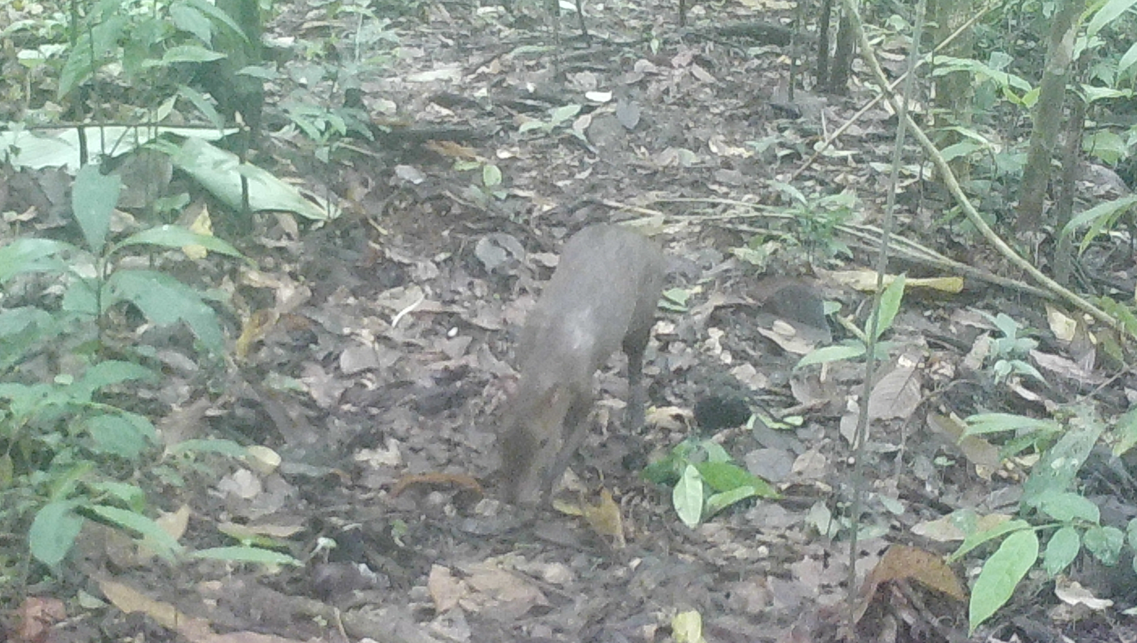
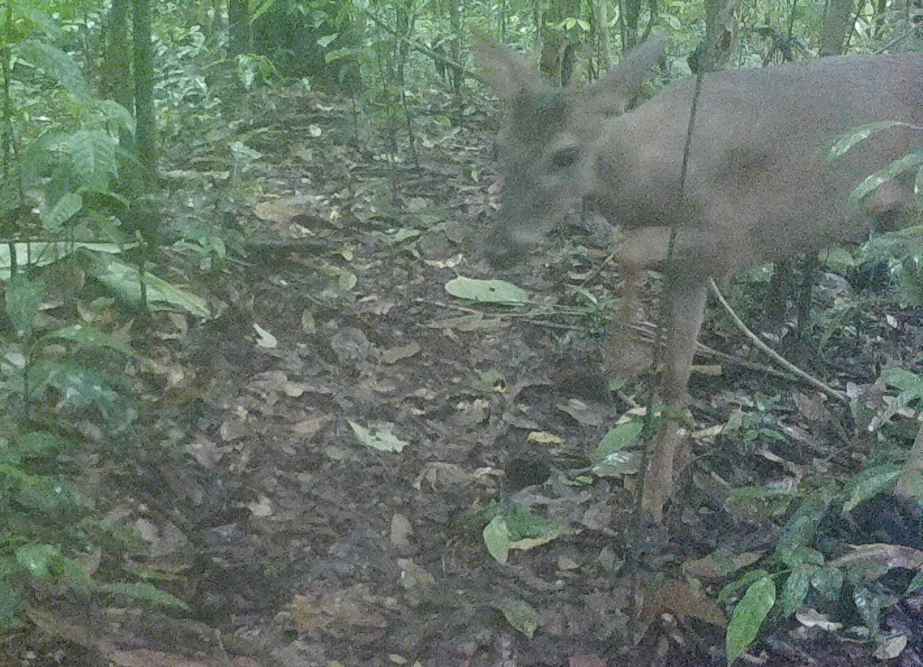
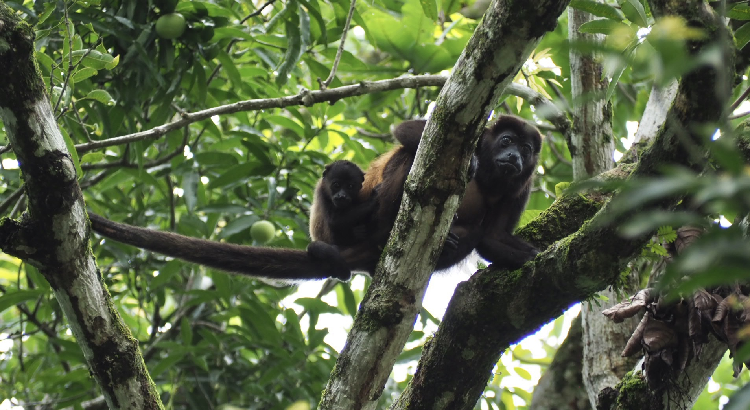
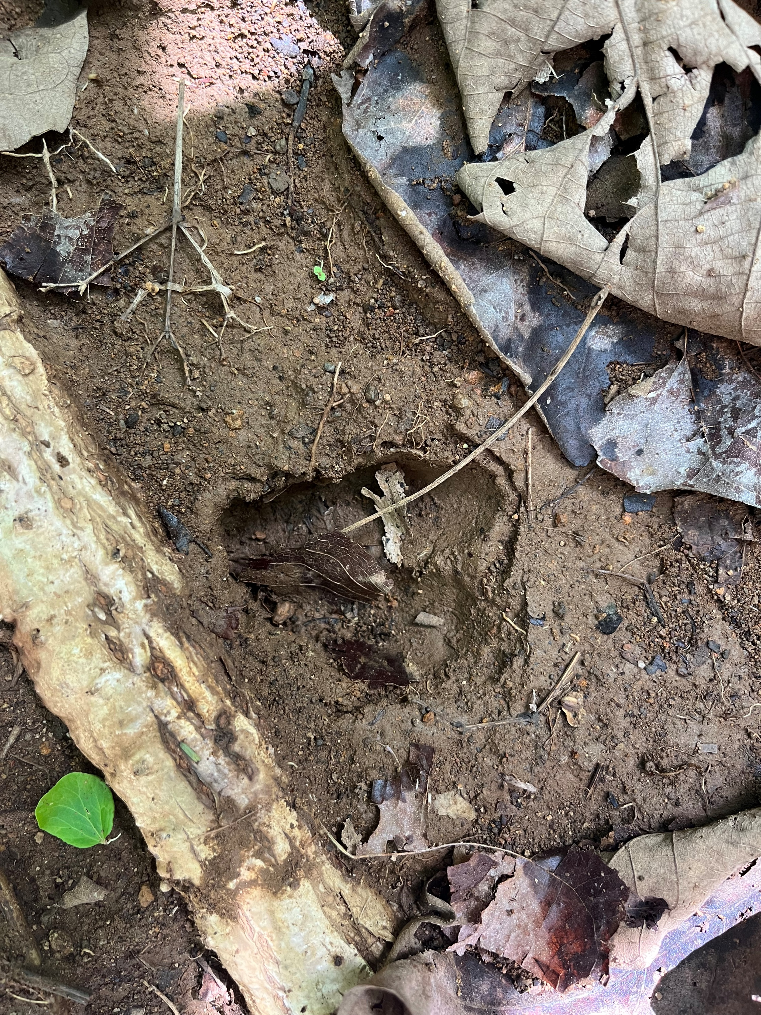
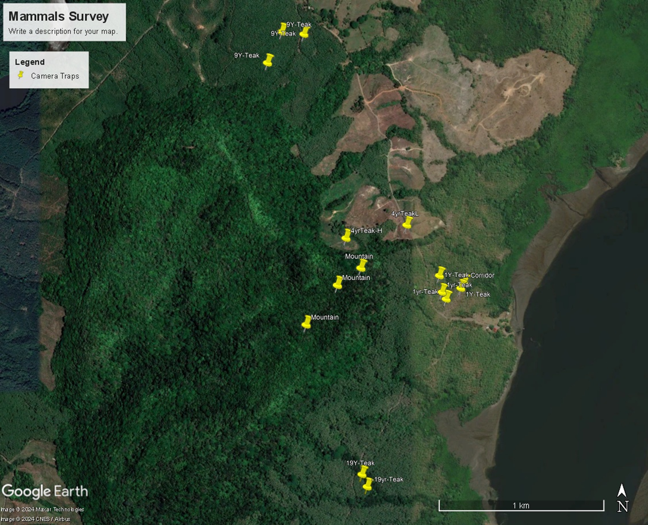
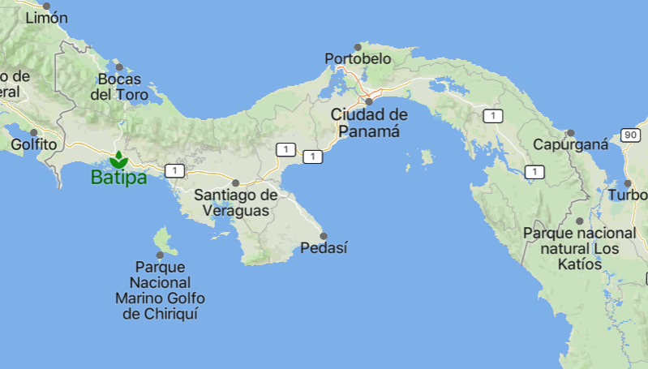
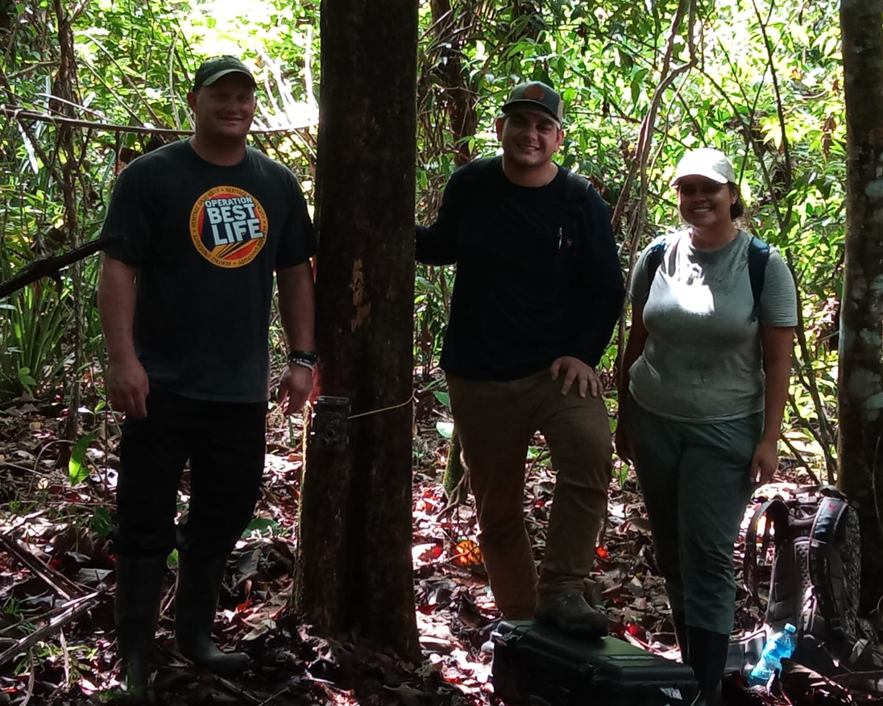
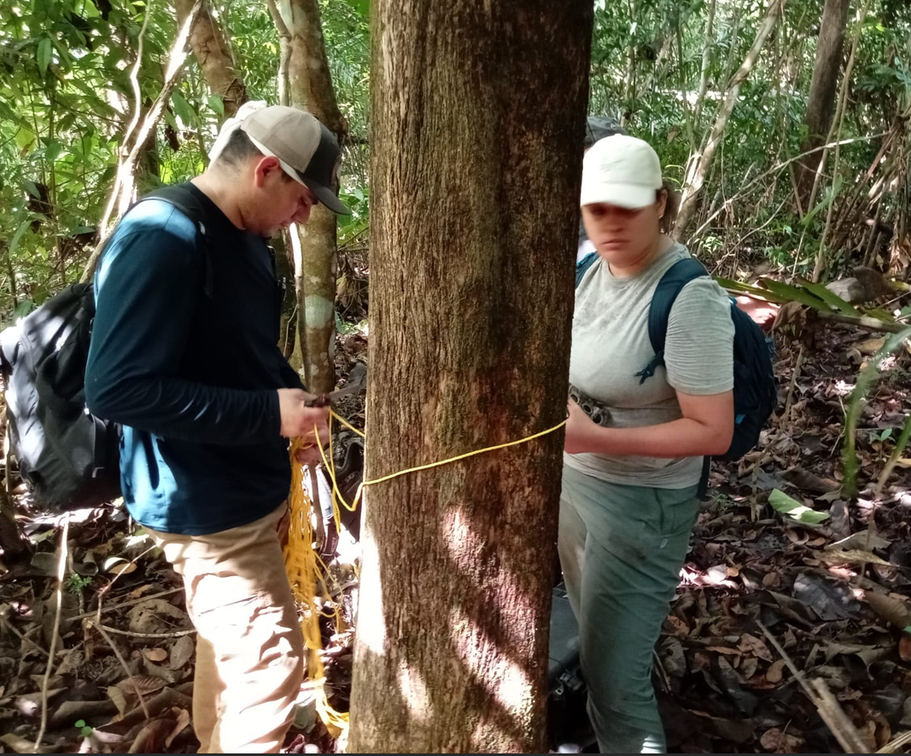
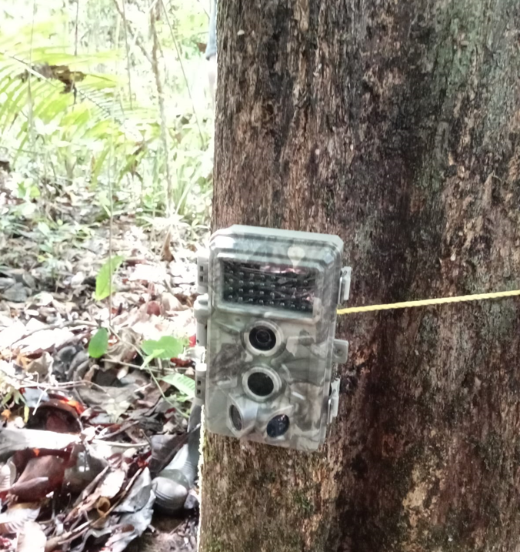
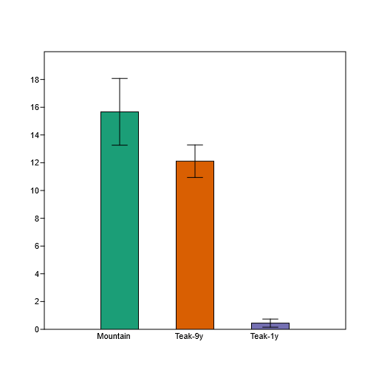
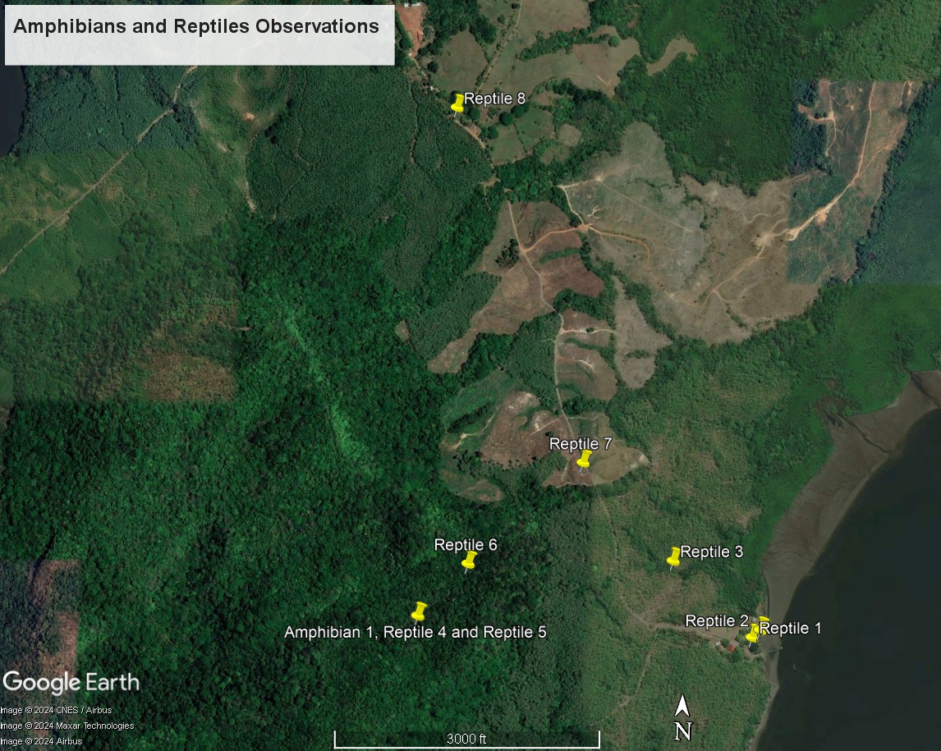
Examining Vertebrate Composition in a Mosaic Landscape at Batipa Peninsula
Nick Tegen¹, Jordon Woodward¹, Deyaneira Rodríguez-Muñoz², Celestino Mariano Gallardo³, and Alberto R. Puente-Rolón²
¹Department of Biology, Heritage University, Washington
²Department of Biology, University of Puerto Rico, Mayagüez Campus
³Comarca Ngӧbe Bugle
Introduction
Cont. Methodology
Cont. Results
Human activity tends to change the physical features of the environment. Leading to a loss of biodiversity and changes in dominant species, keystone species, ecological engineers and the interaction between them (Naeem et al., 2004)
One strategy that has emerged to combat environmental issues such as climate change, soil erosion, and biodiversity loss through reforestation initiatives are tree plantations. However, large-scale tree plantation are not good for wildlife when compared to primary forests (Wang et al., 2022).
The establishment of biological corridors has been proven to be a fundamental strategy for species conservation, as they connect various habitats and ensure the continuity of biological processes. These corridors serve as vital sources of biodiversity within fragmented landscapes (Canet-Desanti et.al. 2012).
Our objective was to determine the composition vertebrates in a mosaic landscape, compose of mature forest, corridors and plantation of different ages.
Amphibians and Reptiles Opportunistic Observations
Figure 5. (A) Lanced-tailed Manikin, Chiroxiphia lanceolata; (B) Dasyprocta sp.; (C) White-tailed deer, Odocoileus virginianus; (D) Unknown species of mammal.
In addition, we documented opportunistically some species of mammals (Figure 6).
Figure 6. (A) White-faced monkeys, Cebus imitator; (B) Howler monkeys, Alouatta palliata;
(C) Deer tracks (White-tailed deer, Odocoileus virginianus).
Bird Point Count Survey
The mature forest habitat exhibited the highest number of bird calls, with an average of 9.67 and the one-year plantation showed the lowest with 0.2 (Figure 7). We compare the number of different calls detected during the census and the mature forests was the one with the highest representation of different calls (One-way Anova, F=45.58,df=2 p=6.173E-09). A Tukey test was used to identify the groups that were different (Table 1). In addition, we compare
the number of birds counted during the surveys and the mature
forest was the one with significant numbers (One-way Anova,
F=26,28,df=2 p=8.94E-07).
Amphibians and Reptiles Opportunistic Observations
Over the course of 18 hours of opportunistic observations,
we documented three species of amphibians and
eight species of reptiles
(Figure 8 and 9).
​
A
B
C
D
All amphibians and reptiles observed, over a period of four consecutive days, were documented using a Garmin Index 20 and photographs were taken to aid in identifying the species to the lowest possible taxonomic level.
Figure 9. (A) Bufo sp.; (B) Spilotes pullatus; (C) Basiliscus basiliscus; (D) Caiman crocodilus​
Figure 3. (A) Amphibian and Reptile Observation (B) Bird Observation
Discussion
The comparison between the 2017 camera trapping study and our survey at Batipa Peninsula, provides valuable insights into the region's biodiversity dynamics. In 2017, utilizing six cameras over a year sampling period, researchers documented nine different species, while our survey, employing 16 cameras outside the previously sample sites documented 30% of the species previously known. This findings may suggest the presence of temporal changes indicating shifts in habitat quality or ecological factors.
Our results showed that the 1-year teak plantation is not used by birds. We were able to observe an average of 26.9 birds using the areas around the plantation. Previous studies have documented that the properties of a matrix in the landscape may influence the resources available and the connectivity (dispersal) of different bird species (Watson et. al 2005).
A
B
Figure 4. Distribution for point count distribution for bird surveys.
Results
Camera Trapping
A total of 120 camera hours were sampled. During this period, six photographs of three mammal species and sixteen photographs of two bird species (males and females) were documented (Figure 5).
Hypothesis
The older forest will exhibit greater vertebrate composition than the younger regrown areas of the mosaic landscape.
A
B
C
D
Conclusions
Methodology
A
We can conclude that although our camera traps did not detect many species the study expands the distribution records for the ones detected.
Within the fragmented landscape birds were more detected at the areas with mature forest.
For amphibians and reptiles our study provides the baseline group of locations for the distribution of the species
In conclusion, older forest exhibits greater vertebrate composition within the mosaic landscape
Study Site
The Batipa Agroforestal Development is located on the Pacific slope in western Panama. It covers 4,000 hectares, including teak plantations, mature forests, corridors, pastures, and mangroves. The elevations range from 0 to 325 meters and has an average annual temperature of 27.5°C and 2767 mm of rainfall.
Camera Trapping
We set 16 camera traps as follows:
Two in the four-year teak plantation
four in the Mature Forest
four in the nine-year teak plantation
One in a corridor
Three in the one-year teak plantation
Two at the 19-year teak plantation
(Figure 1.).
All cameras were set at one meter
high and camara models used were
Meidase model SL122 ( Meidase,USA)
and Meidase model no.:BTC-6HD-940.
Bird Point Count Survey
The point count survey method was employed to estimate bird composition. The habitats studied were mature forest, nine-year-teak plantation and one-year teak plantation. At each site, three points with a 200m separation were marked using measuring tape and flagging (Figure 4). Surveys were conducted for three consecutive days from 6:00 AM to 8:00 AM. At each point, a 5-minute acclimation period was followed by a 15-minute survey. Birds were categorized by its call, and the numbers of birds calling were documented during the sampling period. In addition, to produce a list of birds, we opportunistically documented and identify birds using the Birds of Panama field guide (Angehr and Dean, 2010).
A
B
C
Future Work
Increase the number of cameras deployed in each area, include baiting and expand the sampling period
Establish permanent bird census plots and implement the use of mist nest.
Use a combination of methos for amphibians and reptile surveys
Figure 1. Camera traps distribution for vertebrate detection survey
Work Cited
Canet-Desanti, Lindsay & Herrera-Fernández, Bernal & Finegan, Bryan. (2012). Efectividad de manejo en corredores biológicos: el caso de Costa Rica. Parques. 2.
Naeem, S., Duffy, J. E., & Zavaleta, E. (2004). The functions of biological diversity in an age of extinction. Ecology, 85(7), 1615–1622. https://doi.org/10.1890/04-0922
Wang, C., Zhang, W., Li, X., & Wu, J. (2022). A global meta-analysis of the impacts of tree plantations on biodiversity. Global Ecology and Biogeography, 31(3), 577-590. https://doi.org/10.1111/geb.13440
Watson, J.E.M., Whittaker, R.J. and Freudenberger, D. (2005), Bird community responses to habitat fragmentation: how consistent are they across landscapes?. Journal of Biogeography, 32: 1353-1370. https://doi.org/10.1111/j.1365-2699.2005.01256.x
Figure 2. Research group setting up camera traps.
Number of Birds
Study Sites
Figure 7. Number of Birds per Site
Acknowledgements
Figure 8. Distribution of observations of amphibians and reptiles
Table 1. Tukey test results for the One-way ANOVA, pink color = significant results
This project was funded by the NSF Hispanic Serving Institution Program: Culturally Responsive Education in STEM (CRESCENT) Award 1928570 to J. Black and NSF EAGLES S-STEM Award #1930564.

