Slide 1
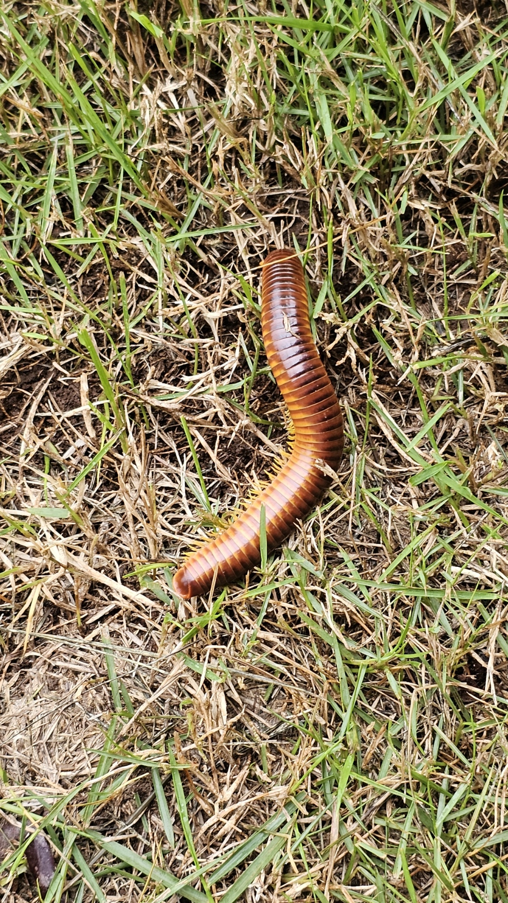
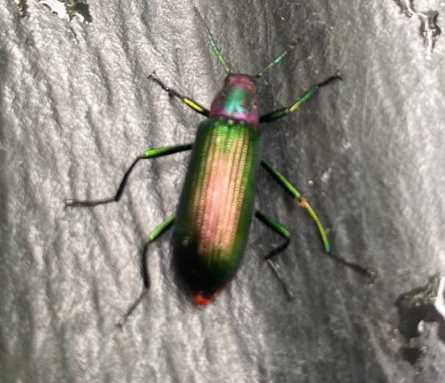
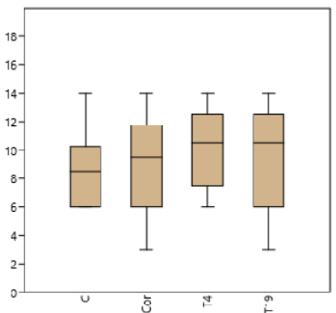
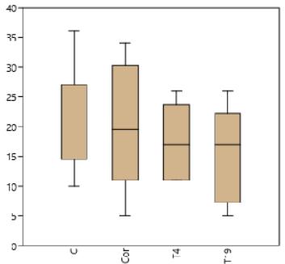
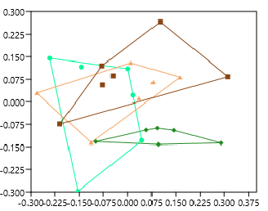
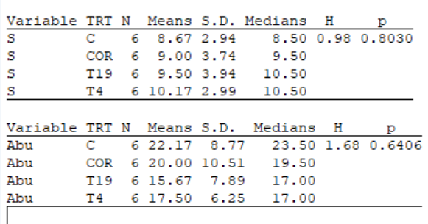
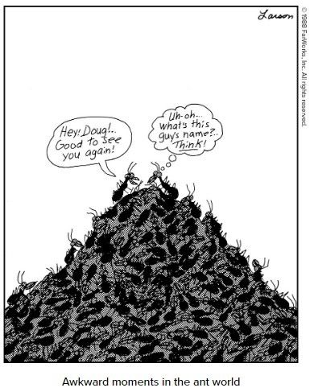
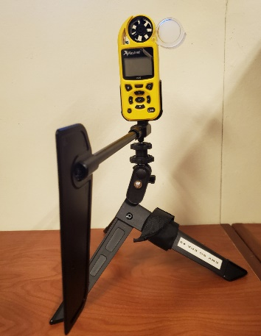
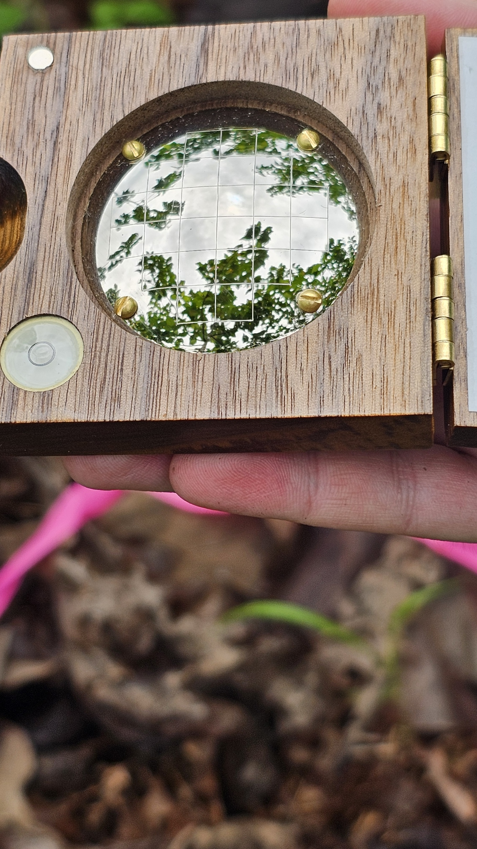
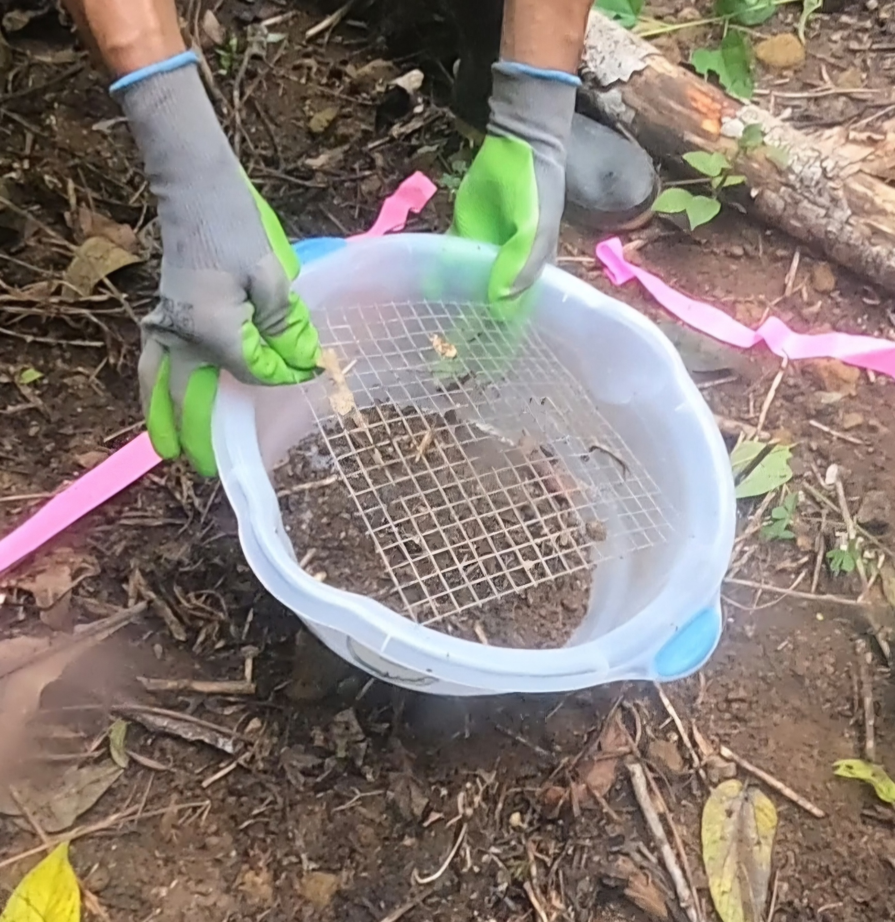
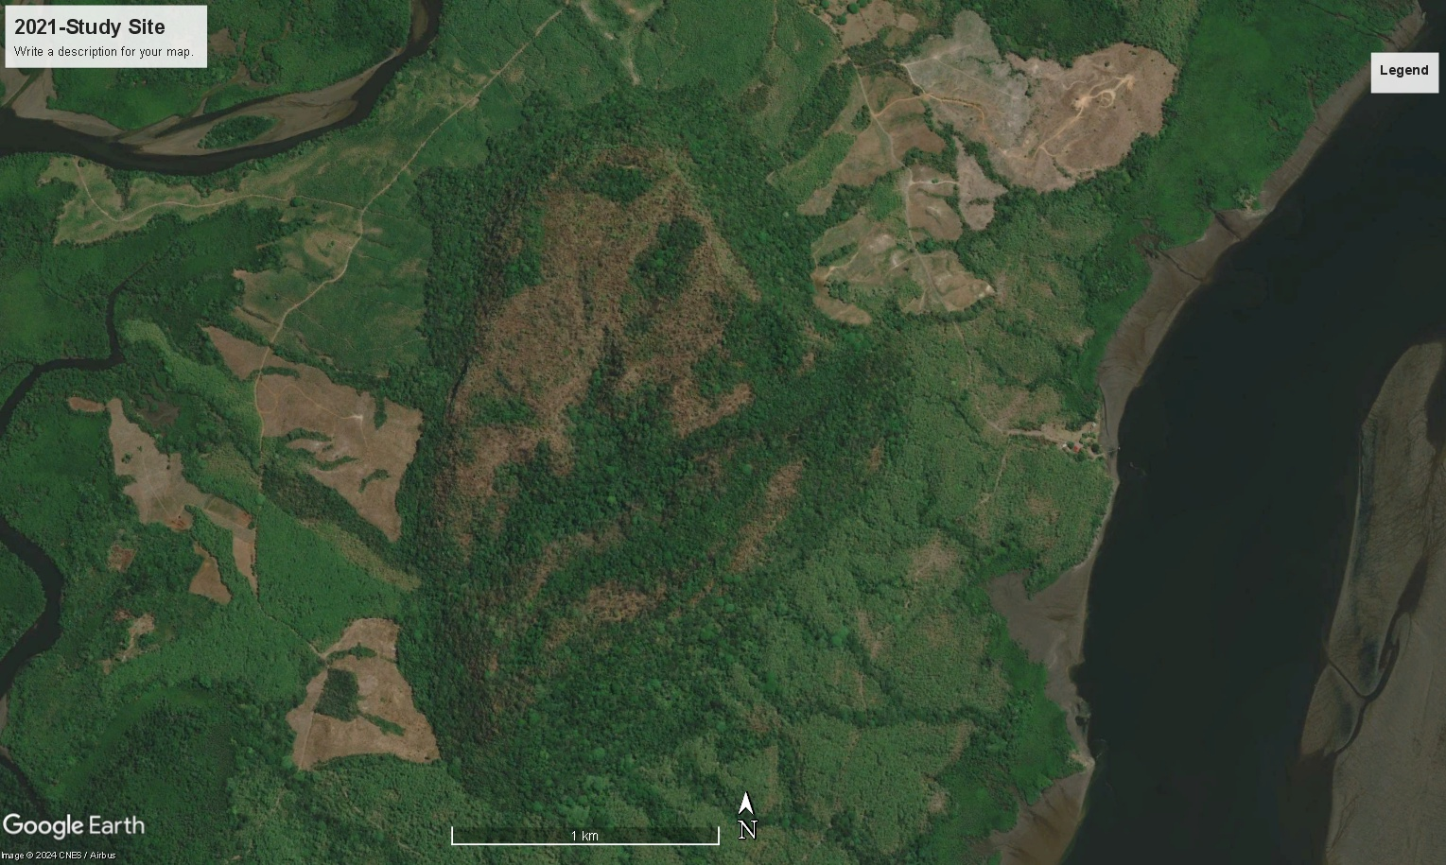
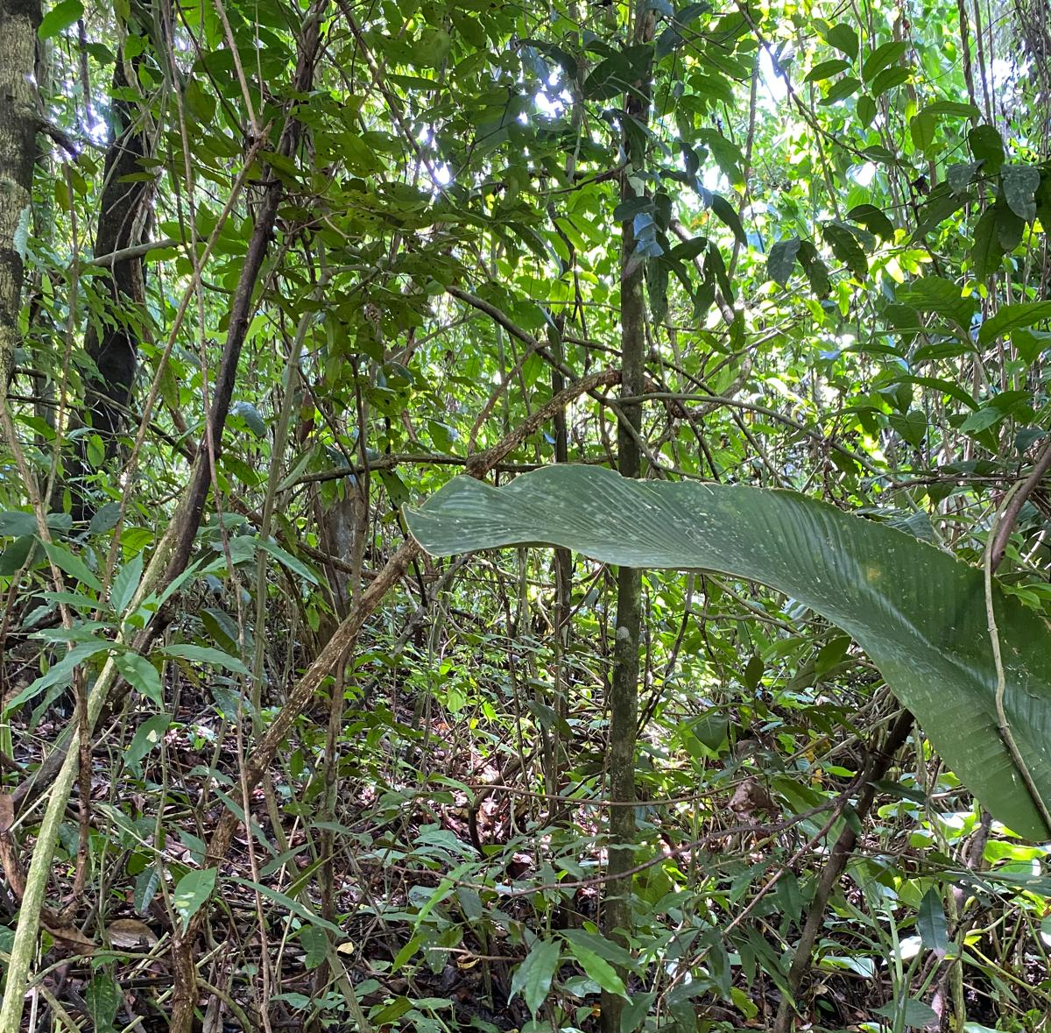
Don’t Count Your Arthropods Before They Hatch
¹Harris M, ¹Hernandez Guzman A, ³Guerra V, ³Aguirre Giron R, ²Acosta Mercado D
¹Heritage University, Toppenish, WA, ²University of Puerto Rico, Mayagüez, ³Comarca, Ngöbe, Panama
Background
Take-Home message
Does Arthropod Community Structure Differ Among Four Management Treatments?
Only in species composition.
Arthropods comprise more than 2/3 of all terrestrial species and are important to the ecological well-being of ecosystems. They are a major part of many food webs, so anything that hurts them will throw the rest of it off. (Bradford&Garcia, 2018) In the past 30 yrs, forest temperatures have risen by around 2°C. Climate warming is a major factor driving reductions in arthropod abundance; even small temperature changes can have drastic effects on the fitness and abundance of species. In addition, deforestation events leave less suitable habitat available for species with narrow thermal ranges. (Olison, 1994) But long-term data on the population and extinction of Arthropods is severely limited, especially in the tropics. (Bradford&Garcia, 2018) This lack of data may mean that some of our current biodiversity management practices need to be reconsidered.
Species Richness in Different Areas
Abundance of Species in Different Areas
In general, there’s no significant difference in population between management practices. This may be due to the fact that:
This is potentially an early succession after recent disturbance. Or:
The area is already so impacted and fragmented that it lost capacity for resilience.
We don’t have enough past data to compare to, so it’s difficult to tell what’s going on.
We recommend applied nucleation, which creates islands of small forested areas. Animals can spread the seeds, making it cheaper than completely reforesting and faster than letting the deforested area sit.
2. Will the Corridor Have Similar Levels of Biodiversity to the Conservation Area?
Yes, since the area has been highly disturbed until recently.
References
Methods
Bradford C. L, & Garcia. A (2018). Climate-driven declines in arthropods
Abundance restructure a rainforest food web
Olson D. (1994). The distribution of leaf litter invertebrates along a neotropical altitudinal gradient
Zanini M. A. et al (2021) The Effects of Ecological Restoration Methods on Carbon Stocks in The Brazilian Atlantic Forest
Segura M, Kanninen M. (2005) Allometric Models for Tree Volume and Total Aboveground Biomass in a Tropical Forest in Costa RIca
Kestrel
Densiometer
Sieving
T (°C)
WS(Km/h)
P (hPa)
% humidity
Altitude (m)
DBH
Canopy Gaps
Biomass
S
Abu
Acknowledgments
3. Which Environmental Variable Best Explains The Variation in the Observations? Temperature and DBH.
Thank you to the NSF Hispanic Serving Institution Program: Culturally Responsive Education in STEM (CRESCENT) Award 1928570 and NSF EAGLES S-STEM Award #1930564. for helping to fund the Panama international intercambio Program with the Ngäbe As well as Edmundo Cruz Gonzales and Oteima University for their support.
A special thanks to Alberto Puente for providing the map of the site
T
Species Richness
ABU
$$B_{tot}=21.297022−6.952649\left(DBH\right)+0.7403({DBH)}^{2}$$
(Segura & Kanninen 2005)

Slide 2
QUESTIONS?

